Slide 1

SE321
Lecture 3: HyperText Markup Language (HTML)
SK. Fazlee Rabby
Lecturer
Department of Software Engineering
Daffodil International University

Slide 2
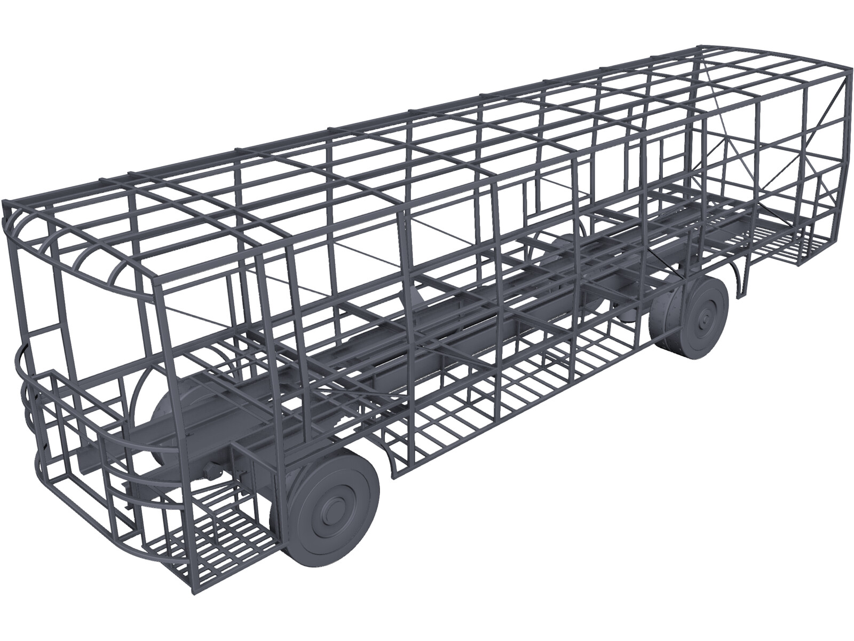
Architecture of Webapges
HTML

Slide 3
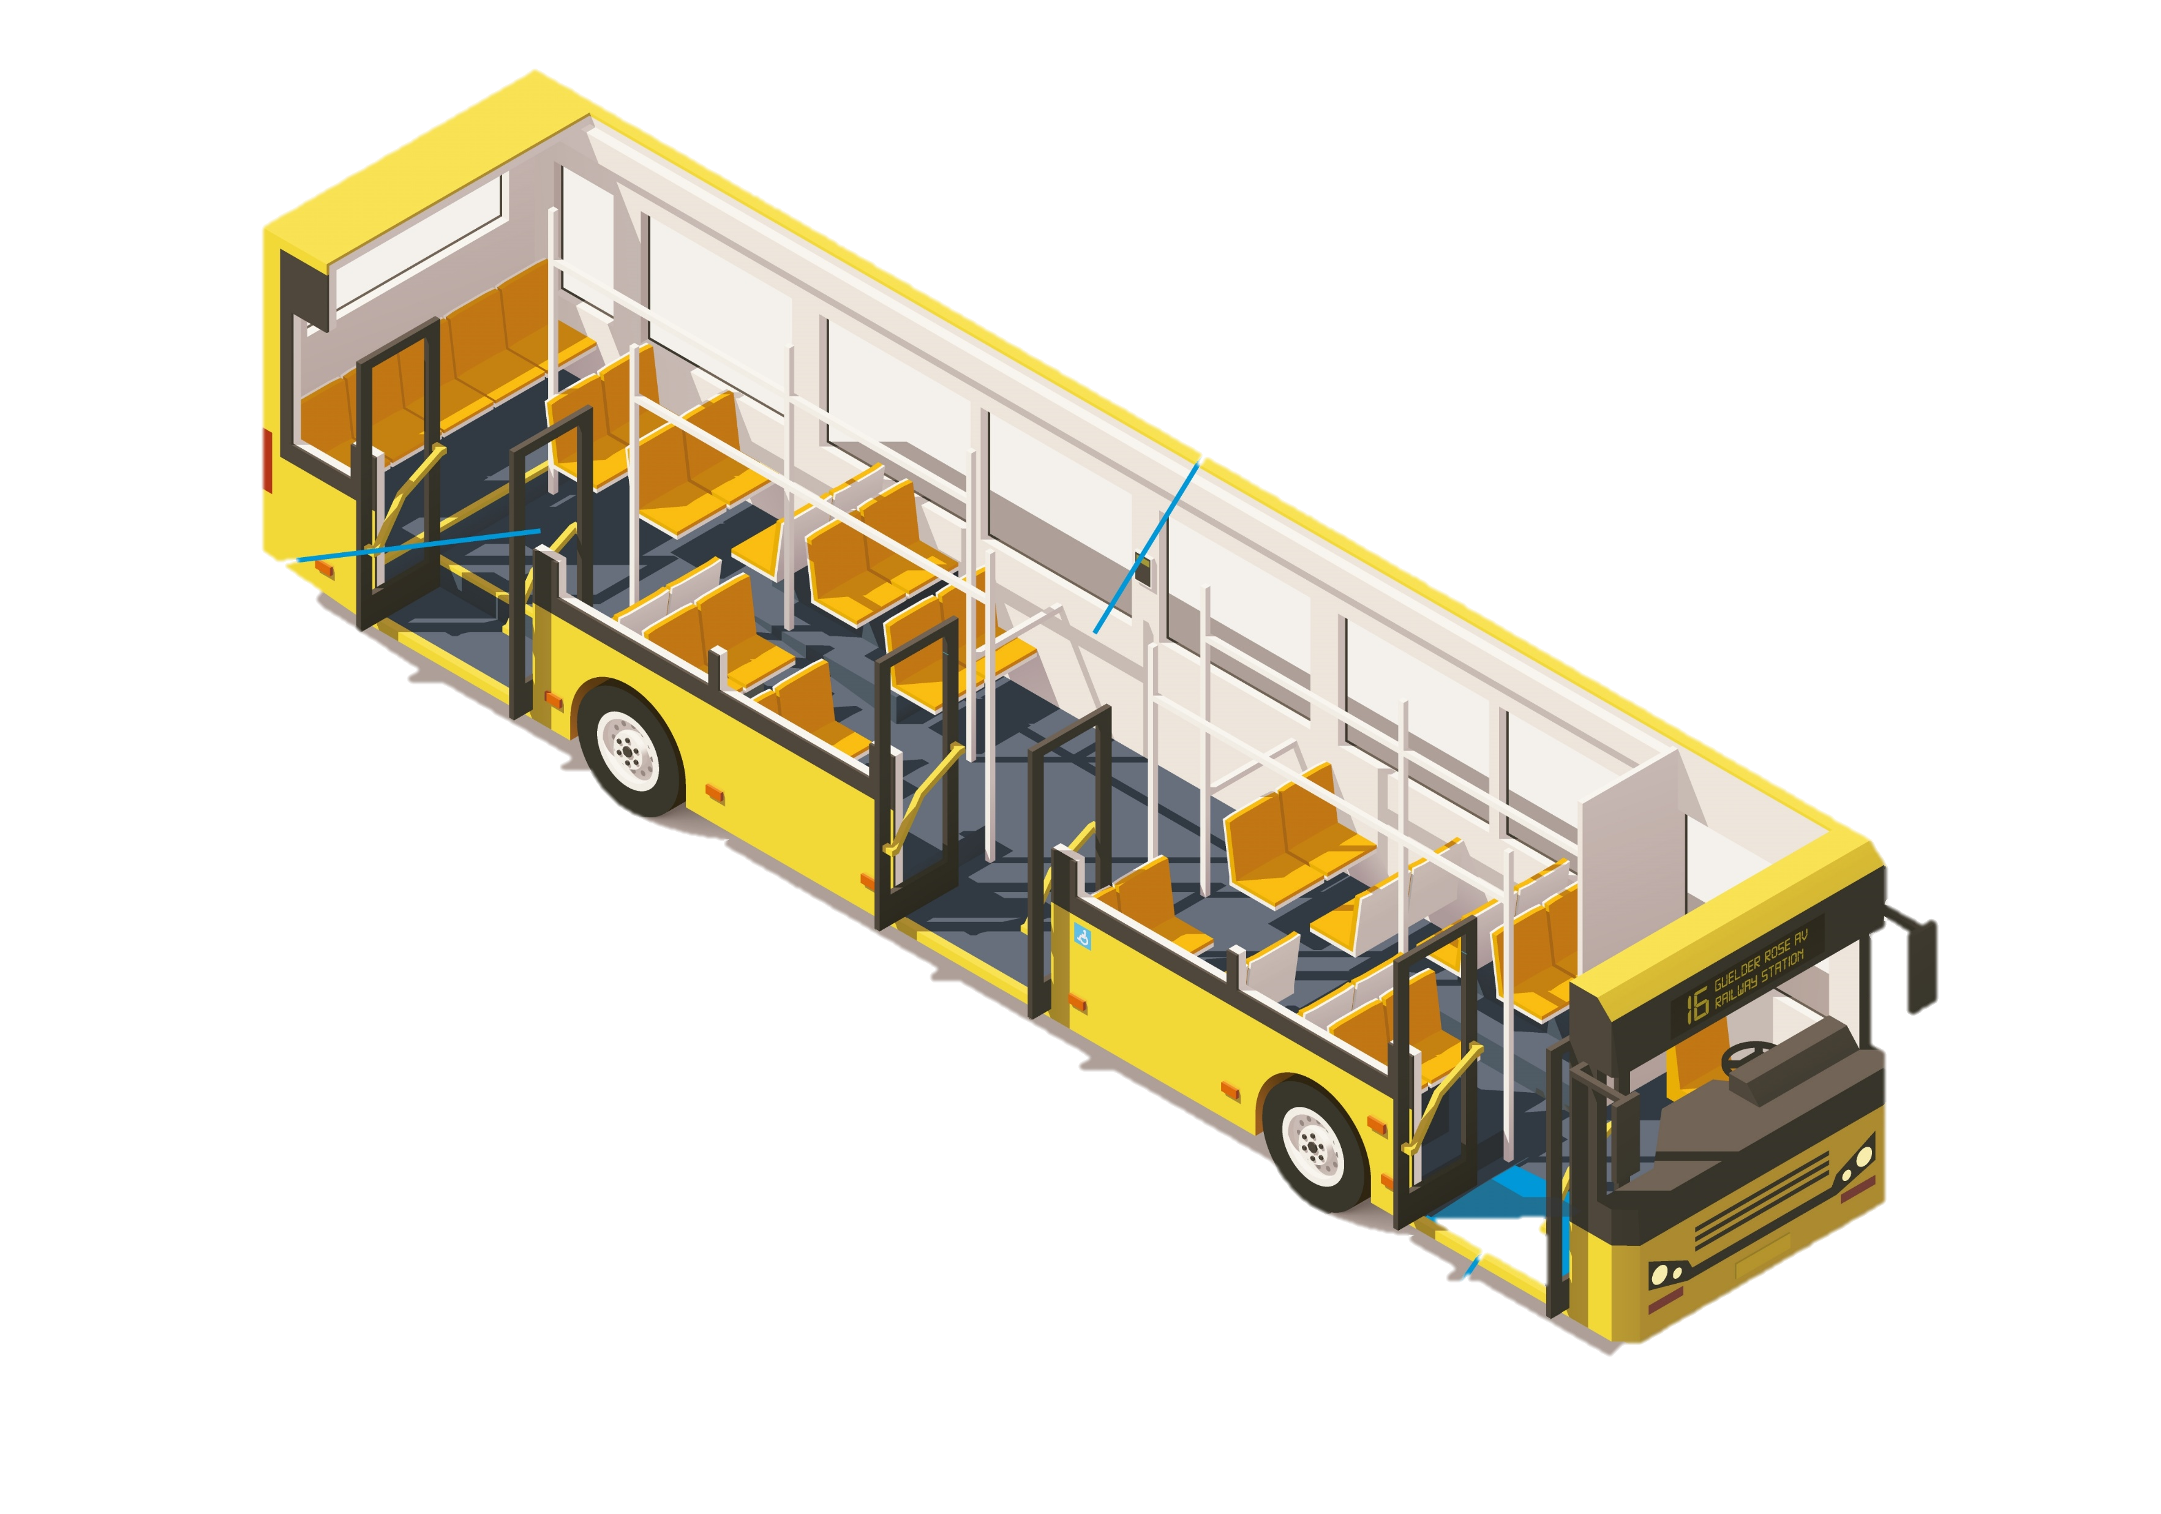
Architecture of Webpages
CSS

Slide 4

Architecture of Webpages
JS

Slide 5
Editing and Running HTML, CSS, JS
Text Editor: You can use whatever you want. We recommend Sublime Text 3.
Browser: HTML, CSS and JS code can be rendered using any Web Browser. We will be using Google Chrome browser for running and debugging HTML, CSS and JS Codes.

Slide 6
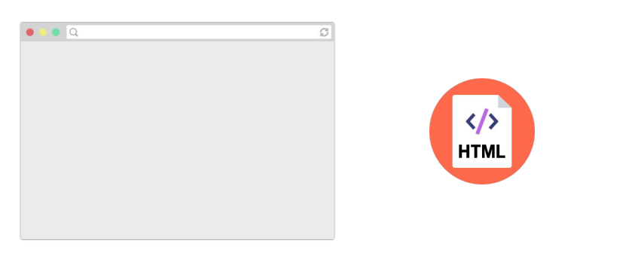
How do web pages work?
Web pages are written in a markup language called
HTML, so browsers display a web page by reading and
interpreting its HTML.

Slide 7
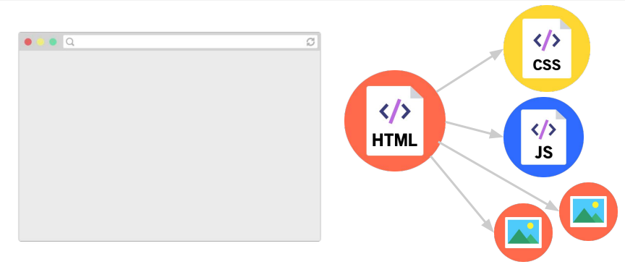
How do web pages work?
The HTML file might link to other resources, like images,
videos, as well as JavaScript and CSS (stylesheet) files,
which the browser then also loads.

Slide 8
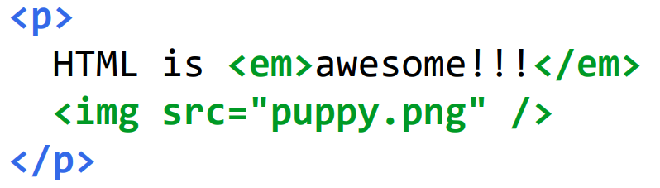
What is HTML?
HTML (Hypertext Markup Language)
- Describes the content and structure of a web page; not
a programming language.
- Made up of building blocks called elements.

Slide 9
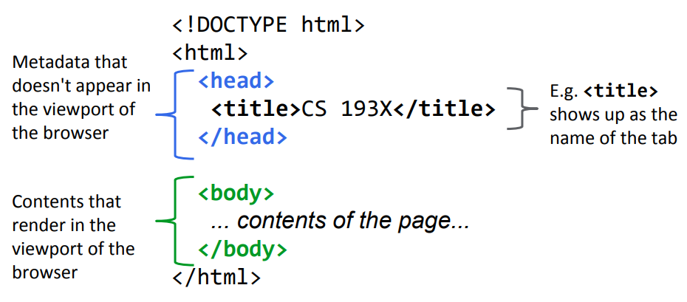
Basic HTML page structure

Slide 10
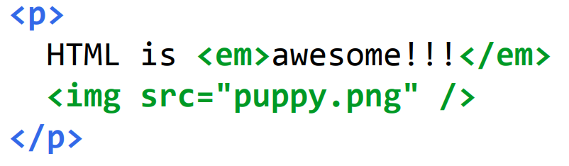
HTML elements
An element usually has start and ending tags (<p> and </p>)
content: stuff in between start and end tags
An element can be self-closing (img)
An element can have attributes (src="puppy.jpg")
Elements can contain other elements (p contains em and img)

Slide 11
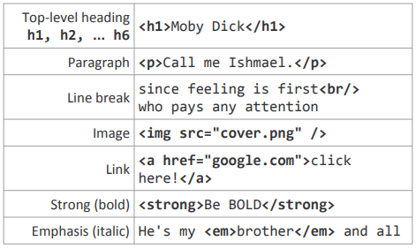
Some HTML elements
To Be Placed Within <body>

Slide 12
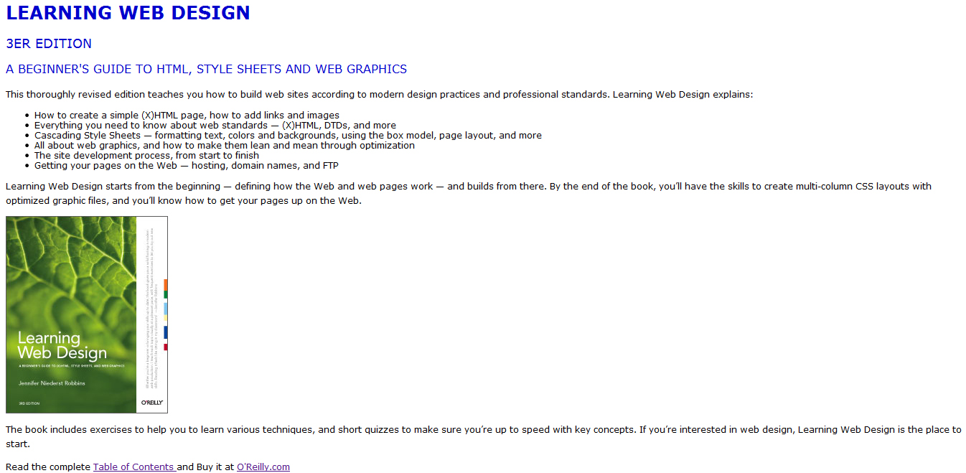
LET’S PRACTICE

Slide 13
WOW ! TEACH ME MORE SENSEI !
W3C

Slide 14
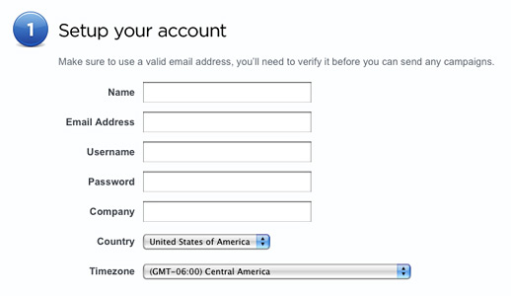

HTML Forms
Browser-to-Server Communication

Slide 15
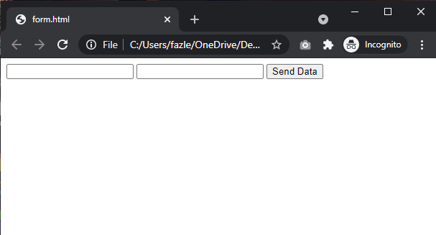
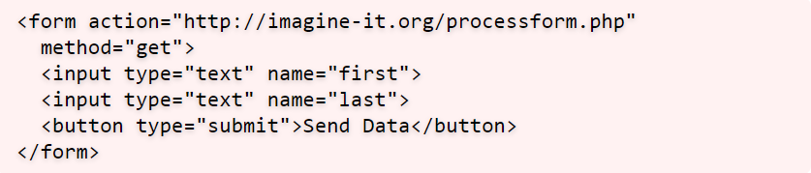
HTML Forms

Slide 16
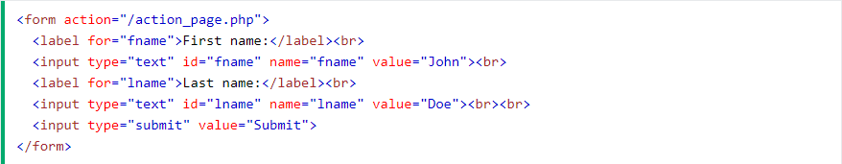
Form Attributes
HTML Form tag can contain several common attributes for declaring methods, actions etc.
The Action Attribute: The action attribute defines where the action is to be performed when the form is submitted. Usually, the form data is sent to a file on the server when the user clicks on the submit button.
In the example below, the form data is sent to a file called "action_page.php". This file contains a server-side script that handles the form data.

Slide 17
Form Attributes
The Method Attribute: The method attribute specifies the HTTP method to be used when submitting the form data. The form-data can be sent as URL variables (with method="get") or as HTTP post transaction (with method="post").
The default HTTP method when submitting form data is GET.

Slide 18
Form Attributes
The Autocomplete Attribute: The autocomplete attribute specifies whether a form should have autocomplete on or off. When autocomplete is on, the browser automatically complete values based on values that the user has entered before.

Slide 19
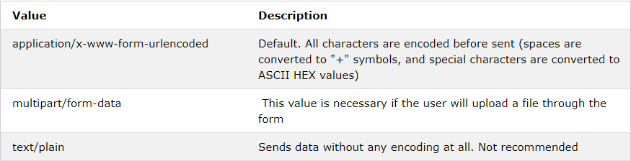
Form Attributes
The Enctype Attribute: The enctype attribute specifies how the form-data should be encoded when submitting it to the server.
Note: The enctype attribute can be used only if method="post".

Slide 20
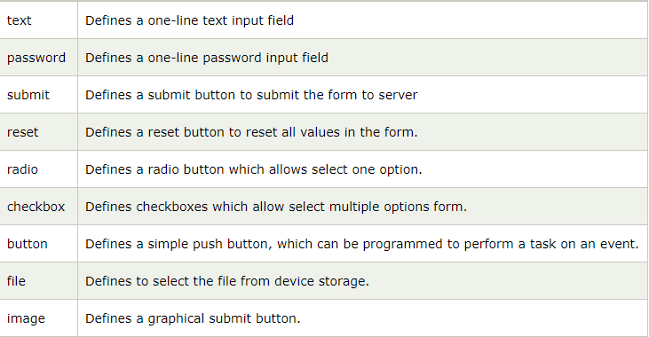
Form Input Elements
The <input> Element: One of the most used form element is the <input> element. The <input> element can be displayed in several ways, depending on the type attribute.
More

Slide 21
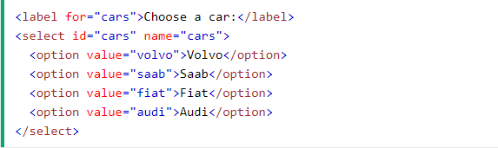
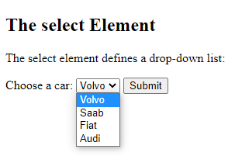
Form Input Elements
The <select> Element: The <select> element defines a drop-down list.

Slide 22
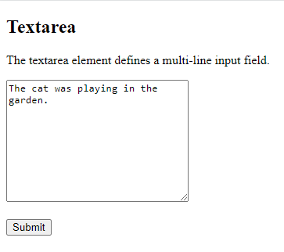
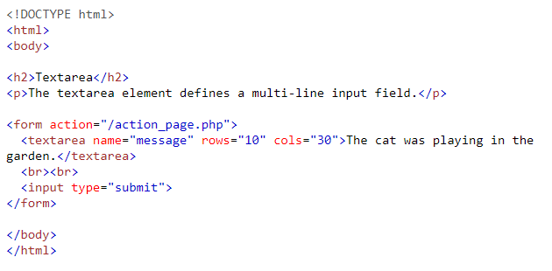
Form Input Elements
The <textarea> Element: The <textarea> element defines a multi-line input field (a text area).

Slide 23
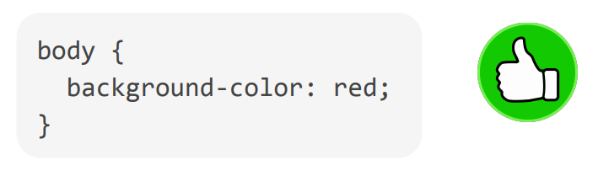
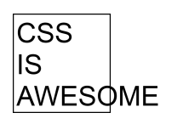
Every beginner CSS tutorial makes CSS look trivially easy
But then when you try to write CSS, literally nothing works

Slide 24
Q: Why is HTML/CSS So Bizarre??

Slide 25
A: There is one crucial set of rules That We Need to Learn
Block vs Inline display

Slide 26
What is HTML?
HTML (Hypertext Markup Language)
- Describes the content and structure of a web page
- Made up of building blocks called elements.
There are 3 basic types

Slide 27
Types of HTML Elements
Each HTML element is categorized by the HTML spec into one of three-ish categories:
Block: Large blocks of content, has height and width. Ex.: <p>, <h1>, <blockquote>, <ol>, <ul>, <table>
Inline: Small amount of content, no height or width Ex.: <a>, <em>, <strong>,<br>
Inline Block: Inline content with height and width
Metadata: information about the page, usually not visible

Slide 28
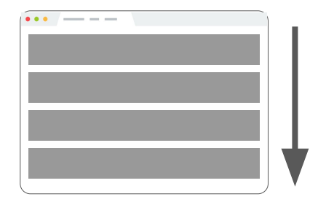
Block Elements
Examples:
<p>, <h1>, <blockquote>, <ol>, <ul>, <table>
Take up the full width of the page (flows top to bottom)
Have a height and width
Can have block or inline elements as children

Slide 29
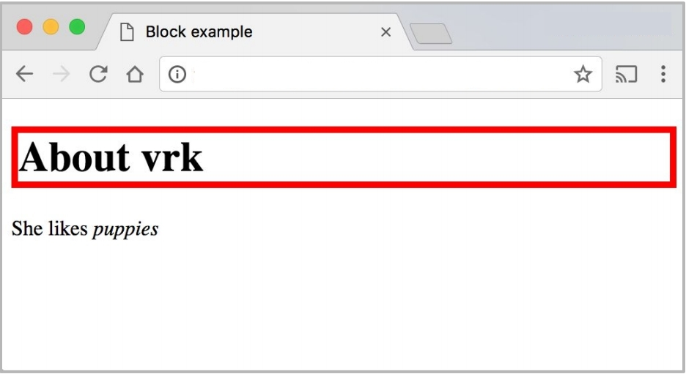
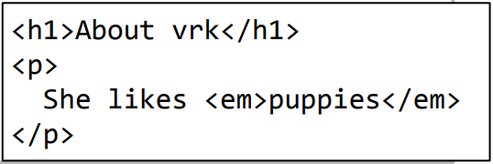
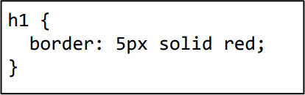
Block Elements
<h1> is block-level, so it extends the full width of the page by default
Note how block-level elements (h1, p) flow top to bottom

Slide 30
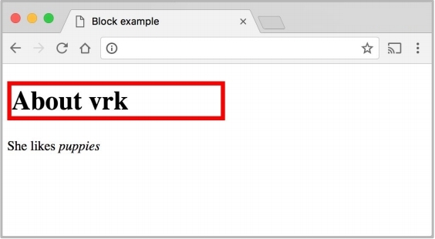
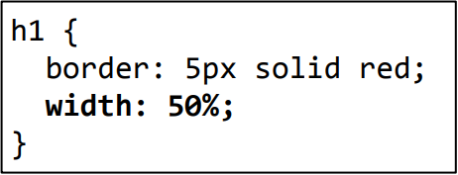
Block Elements
<h1> is block-level, so its width can be modified
Block-level elements still flow top to bottom

Slide 31
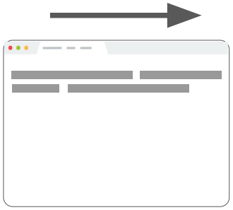
Inline Elements
Examples:
<a>, <em>, <strong>, <br>
Take up only as much width as needed (flows left to right)
Cannot have height and width
Cannot have a block element child
Cannot be positioned (i.e. CSS properties like float and position do not apply to inline elements)
Must position its containing block element instead

Slide 32
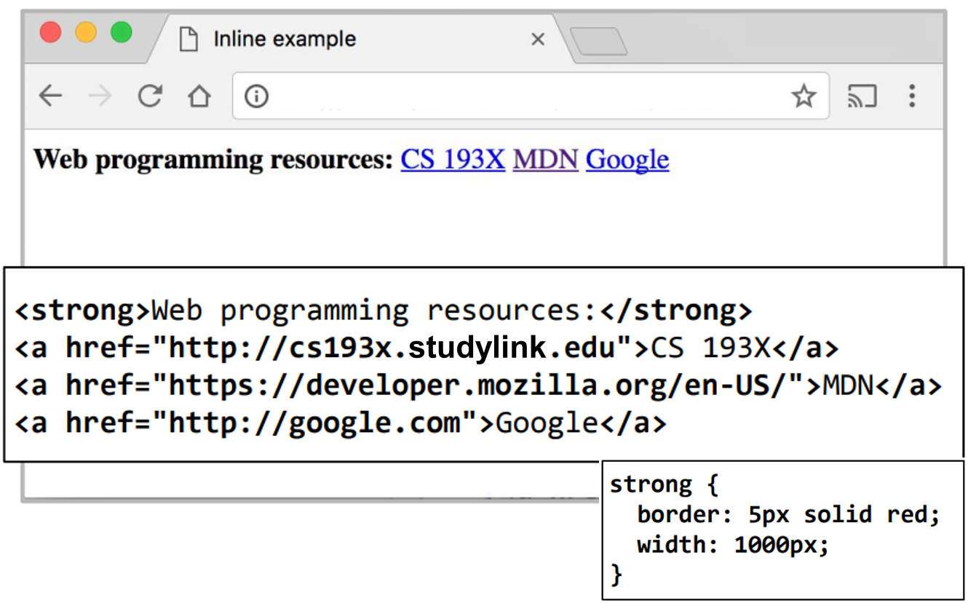
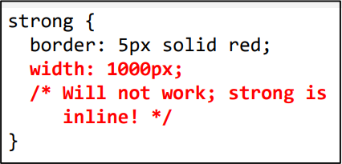
Inline Elements
Cannot set width on inline element, so it is ignored

Slide 33
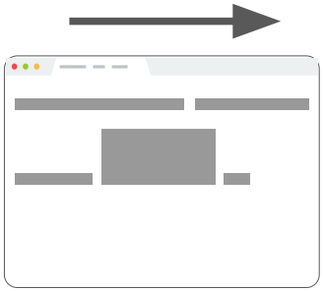
Inline-Block Elements
Examples:
<img>, any element with display: inline-block;
Take up only as much width as needed (flows left to right)
Can have height and width
Can have a block element child
Can be positioned (i.e. CSS properties like float and position do not apply to inline elements)

Slide 34
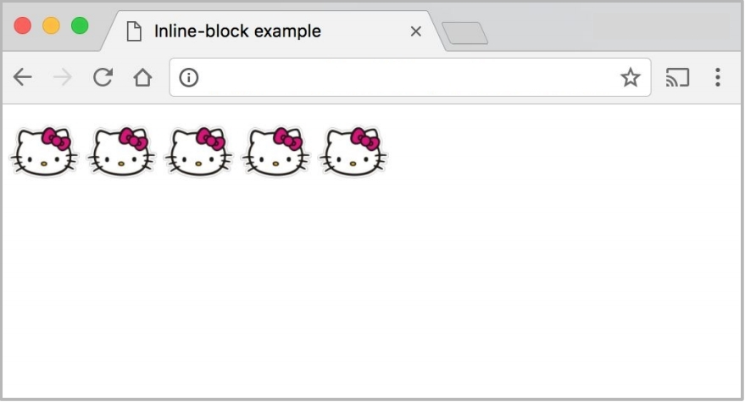
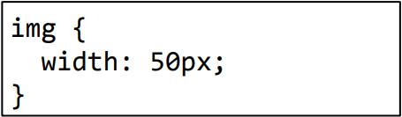
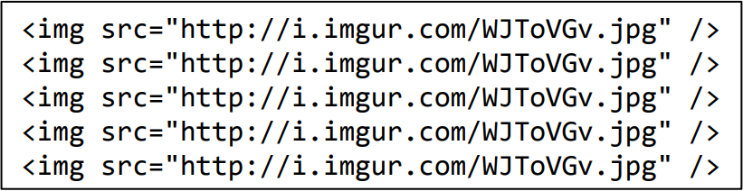
Inline-Block Elements
Can set width on inline-block element, so image width is set to 50px.
inline-block flows left to right, so images are right next to each other.

Slide 35
Moral of The Story
If your CSS isn't working, see if you're trying to apply block-level properties to inline elements

